Slide 1
Smart Baby Crib
Ahmad Achaji
Ahmad Hammoudeh
Sleiman Smaili
Ziad Zok
Supervised by : Dr. Ahmad Koubeissi

Slide 2
Table of contents
01
02
03
Project Motivation
Competitors
Design Constraints
04
05
06
Design Iterations
Design Analysis
Bed-Preheating
07
08
09
Bracelet Electrical system
Bracelet Algorithm
Crib System
10
11
12
Electric System
Mode of Operation
Conclusion

Slide 3
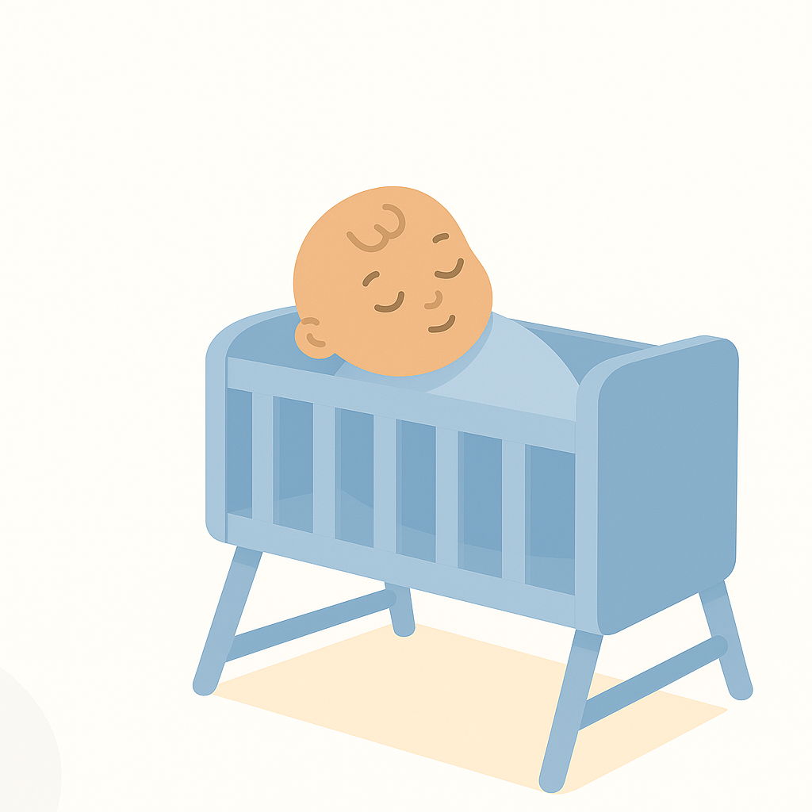
01
Project Motivation

Slide 4


Our goals
Filling a gap
Child’s care
Privacy
Lack of cost-effective solutions in the market
Reliable Solution for the comfort and well being of your baby
Ensure the security of data and privacy of the users

Slide 5
02
Competitors

Slide 6
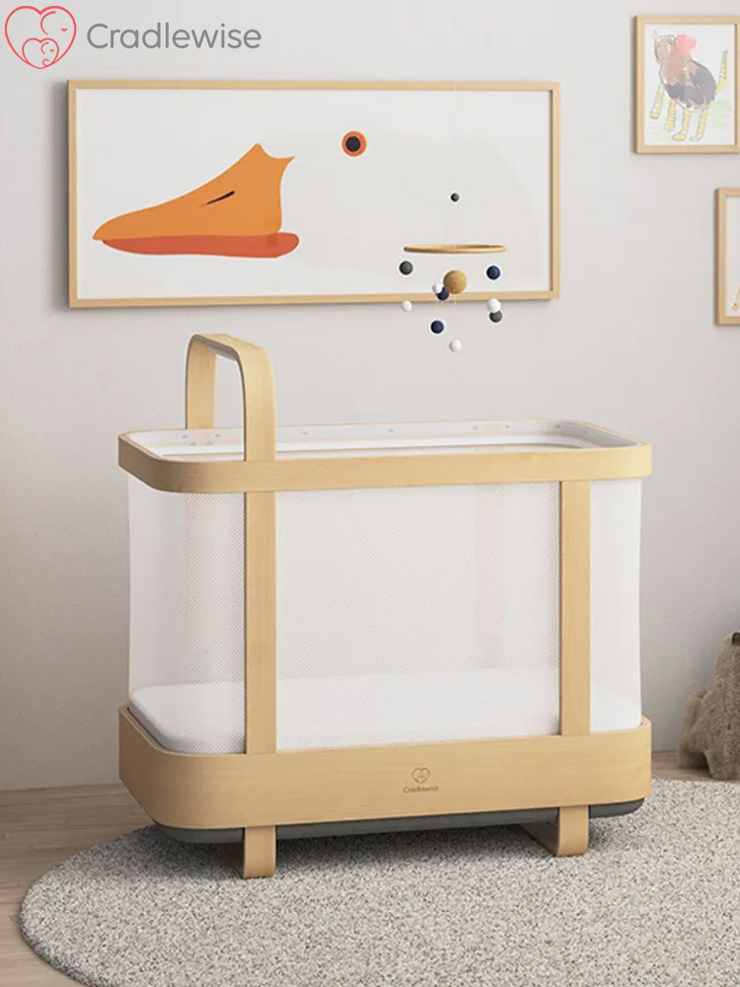
Cradle Wise
Cry Detection | Available
Health Monitoring | Breathing Cycles
Soothing Motion | 1 motion type
Mobile App / Data Collection | Available
Bed Preheating | Not Available
Air Quality | Not Available
Entertainment | White noises
Price | ~2000$

Slide 7
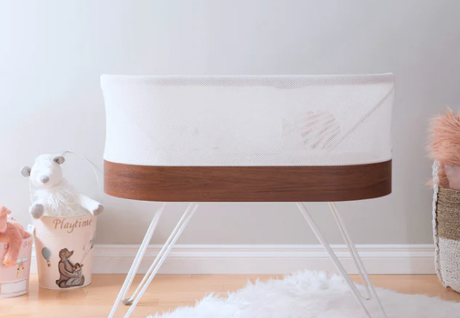
SNOO Smart Sleeper Bassinet
Cry Detection | Available
Health Monitoring | Not Available
Soothing Motion | 1 motion type
Mobile App / Data Collection | Available
Bed Preheating | Not Available
Air Quality | Not Available
Entertainment | Not Available
Price | ~1700$

Slide 8
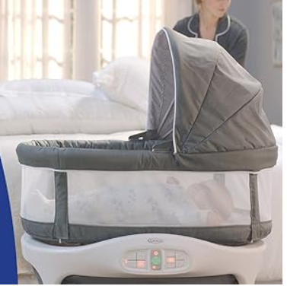
Graco Sense2Snooze Bassinet
Cry Detection | Available
Health Monitoring | Not Available
Soothing Motion | 1 motion type
Mobile App / Data Collection | Not Available
Bed Preheating | Not Available
Air Quality | Not Available
Entertainment | Not Available
Price | ~400$

Slide 9
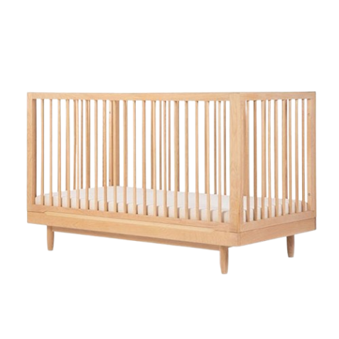
Normal Crib
Cry Detection | Not Available
Health Monitoring | Not Available
Soothing Motion | No motion
Mobile App / Data Collection | Not Available
Bed Preheating | Not Available
Air Quality | Not Available
Entertainment | Not Available
Price | ~150$

Slide 10
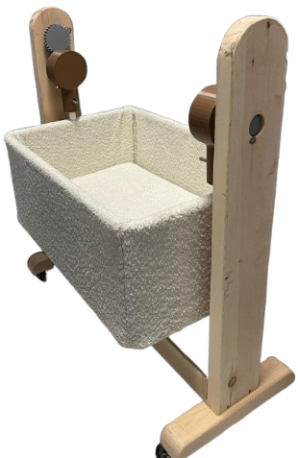
Our Crib
Cry Detection | Available
Health Monitoring | HR, SPO2, and Body Temp
Soothing Motion | 1 motion type
Mobile App / Data Collection | Available
Bed Preheating | Available
Air Quality | Available
Entertainment | Available
Price | Prototype:~700$ Production: ~ 400$

Slide 11
Prices
3d Printed parts : ~75$
Base: 200$
Chassis and cover : 150$
Electrical components: 250$

Slide 12
03
Design Constraints

Slide 13
Economic Consideration
Power Efficiency
200w of power consupmtion
500$
Safety
Portability and Ease of use
Ensure the safety of the user from any harm
User friendly interface, and easy to move design

Slide 14
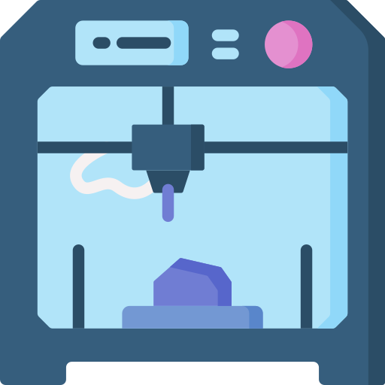

04
DESIGN ITERATION

Slide 15
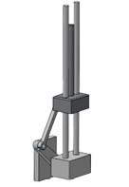
Iteration 1
Leads
Support platform
Slider-Crank mechanism

Slide 16
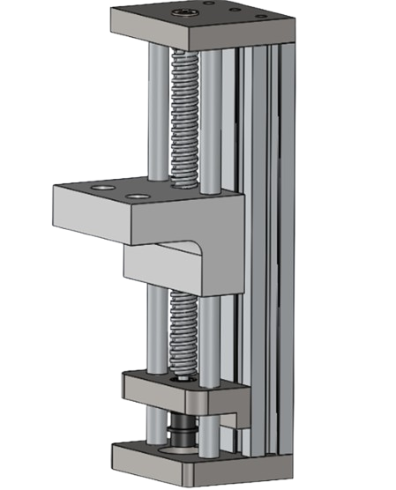
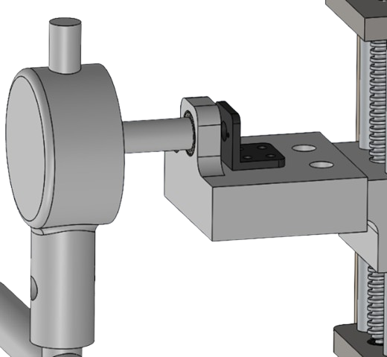
Iteration 2
Leads
Motor Shaft
Support platform
Motor Bracket
Driver Screw

Slide 17
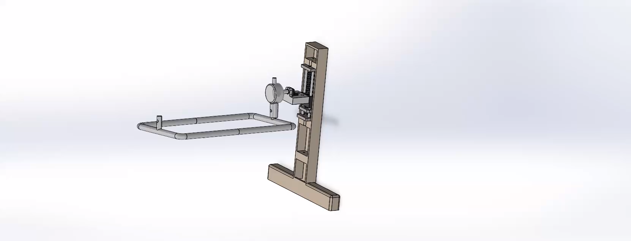
Iteration 2

Slide 18
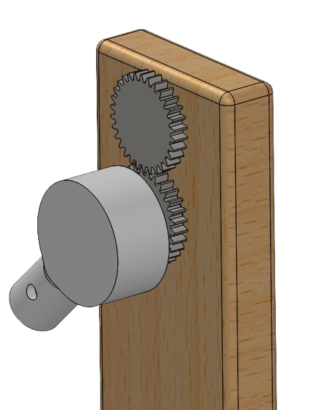
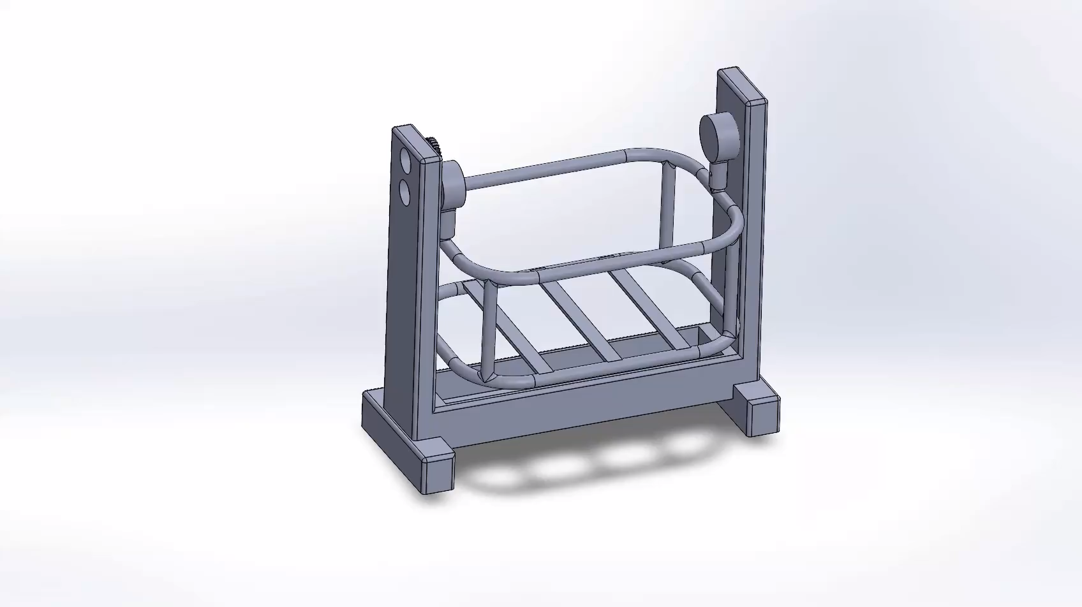
Final Iteration
Driver
Driven

Slide 19
Codes and standards
ASTM F1169-19 | Standard Consumer Safety Specification for Full-Size Baby Cribs | 1-Slat spacing: Prevents babies from slipping through or getting their head stuck. 2-No sharp edges or protrusions 3-Mattress support integrity: Ensures the crib base can handle weight and won’t collapse.

Slide 20
Codes and standards
ISO 7175-1:2019 | Children's Furniture – Beds and Cots – Safety Requirements | 1-General mechanical safety: Prevents finger pinching, crushing, shearing. 2-Tip-over Stability: Especially if the crib has moving or swinging parts. 3-Durability of moving parts and hinges.

Slide 21
Design Analysis
05

Slide 22
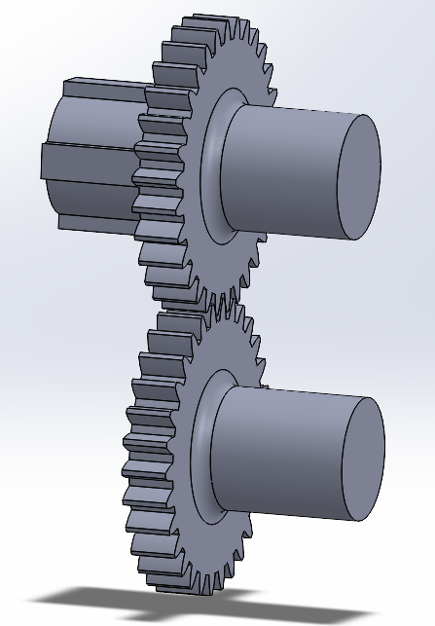
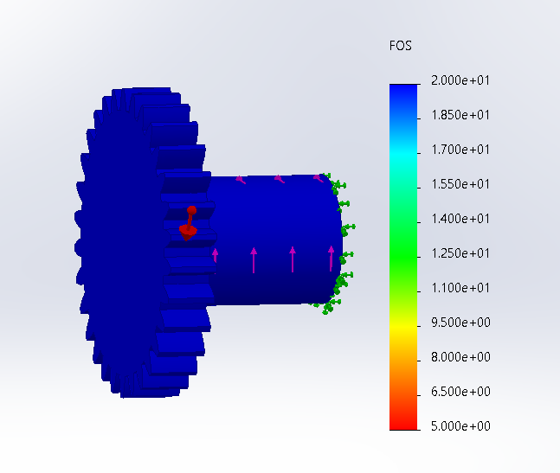
Meshing Gears

Slide 23
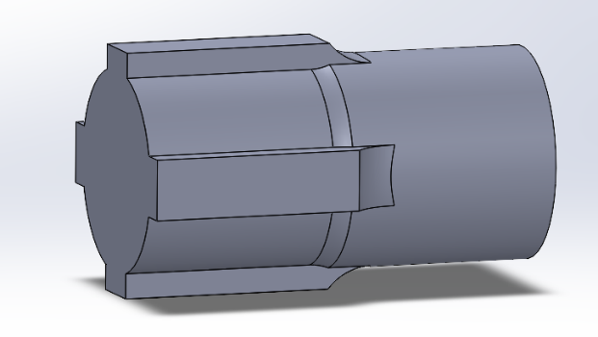
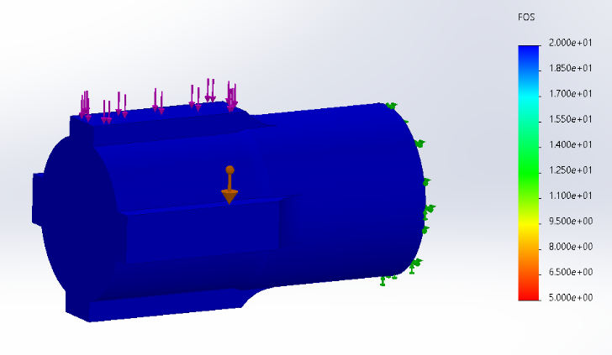
Support Pin

Slide 24
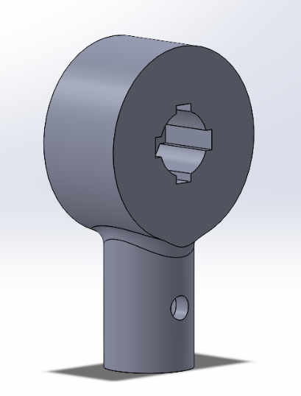
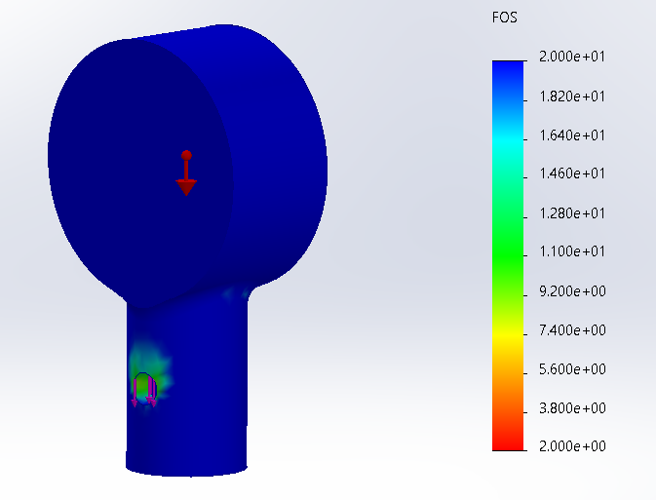
Crib Handles

Slide 25
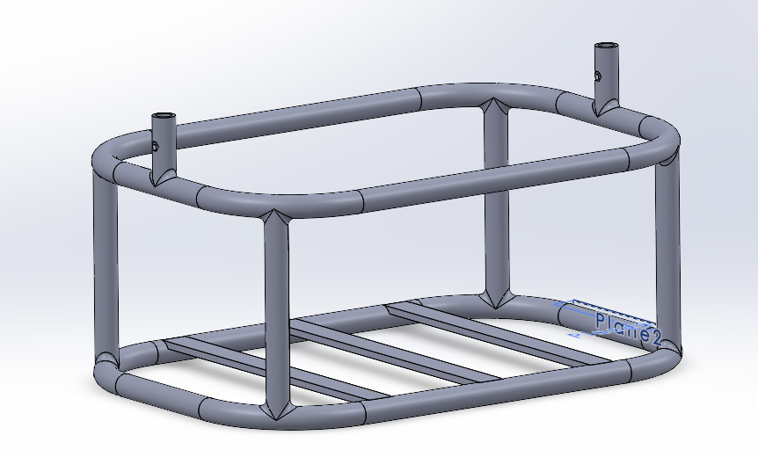
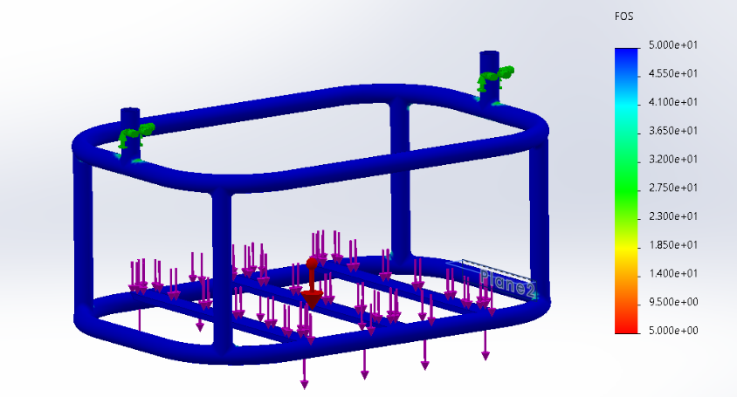
Crib Chassis

Slide 26
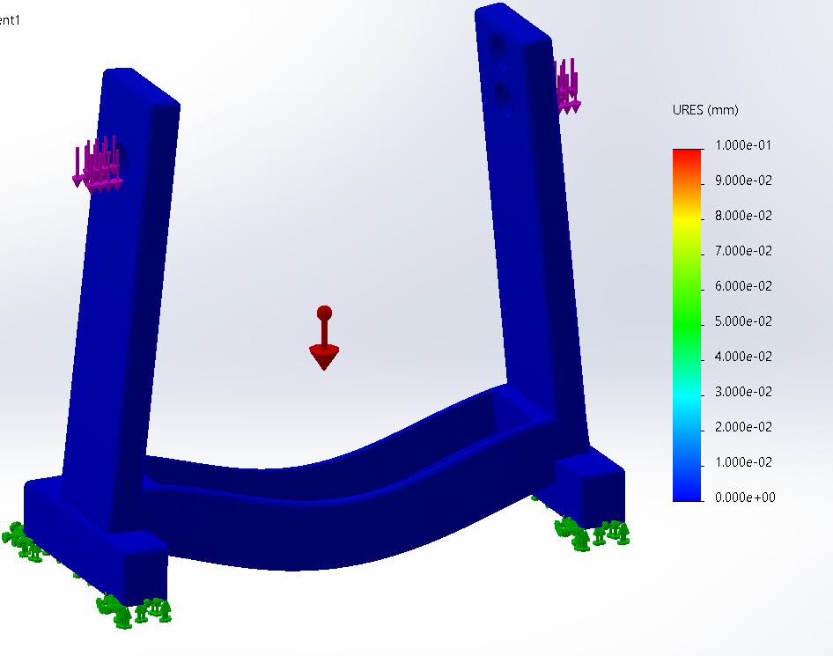
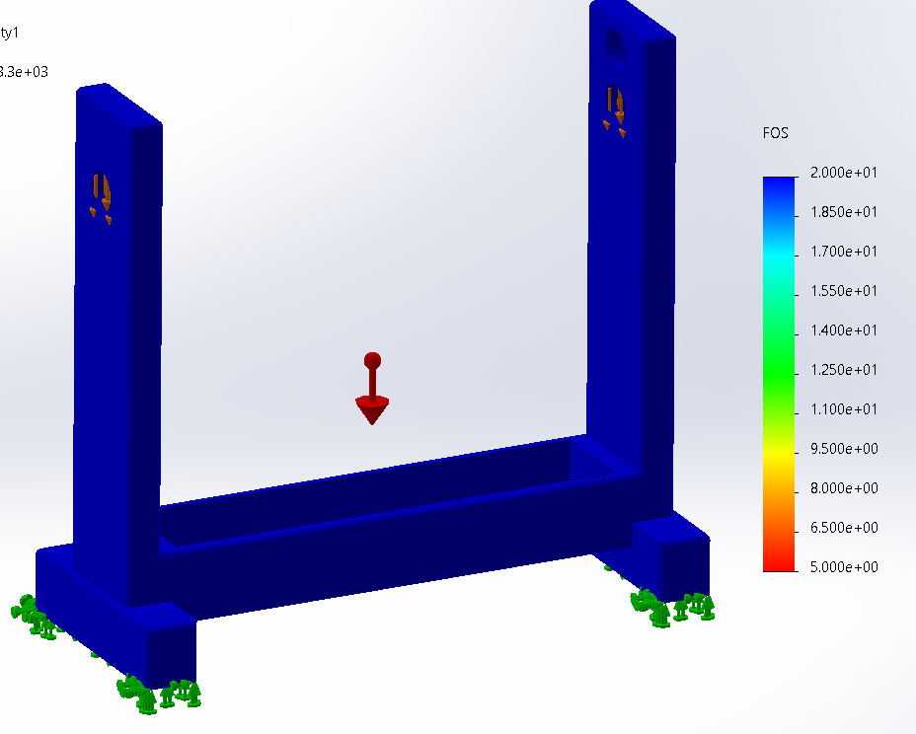
Crib Base
FOS analysis
Displacment analysis

Slide 27
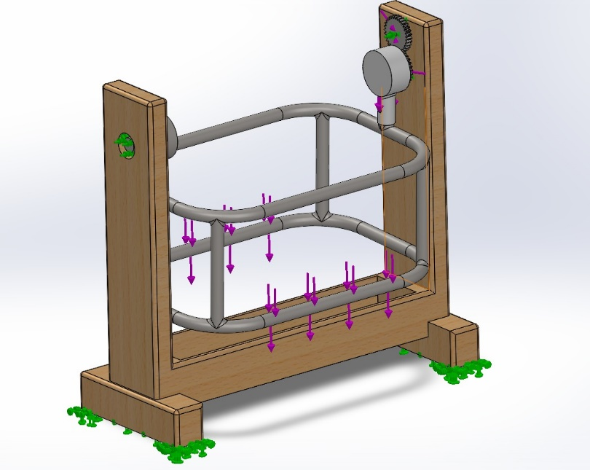
Final Aassembly Simulation

Slide 28
06
Bed Preheating

Slide 29
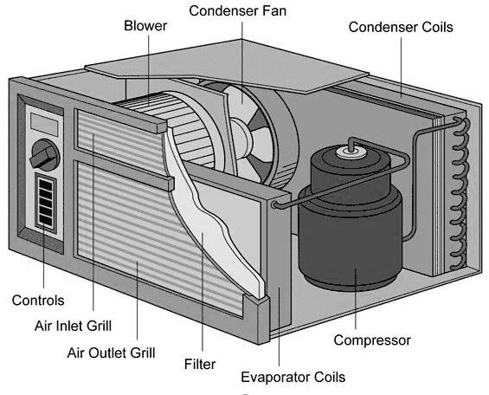
Iteration 1
•The compressor introduced significant noise, potentially disturbing a baby’s sleep.
•High manufacturing cost made the design impractical.
•The unit’s complexity reduced its feasibility.
•Overall, the design was not suitable for a compact and safe infant bed.
Air conditioning system (package system)

Slide 30
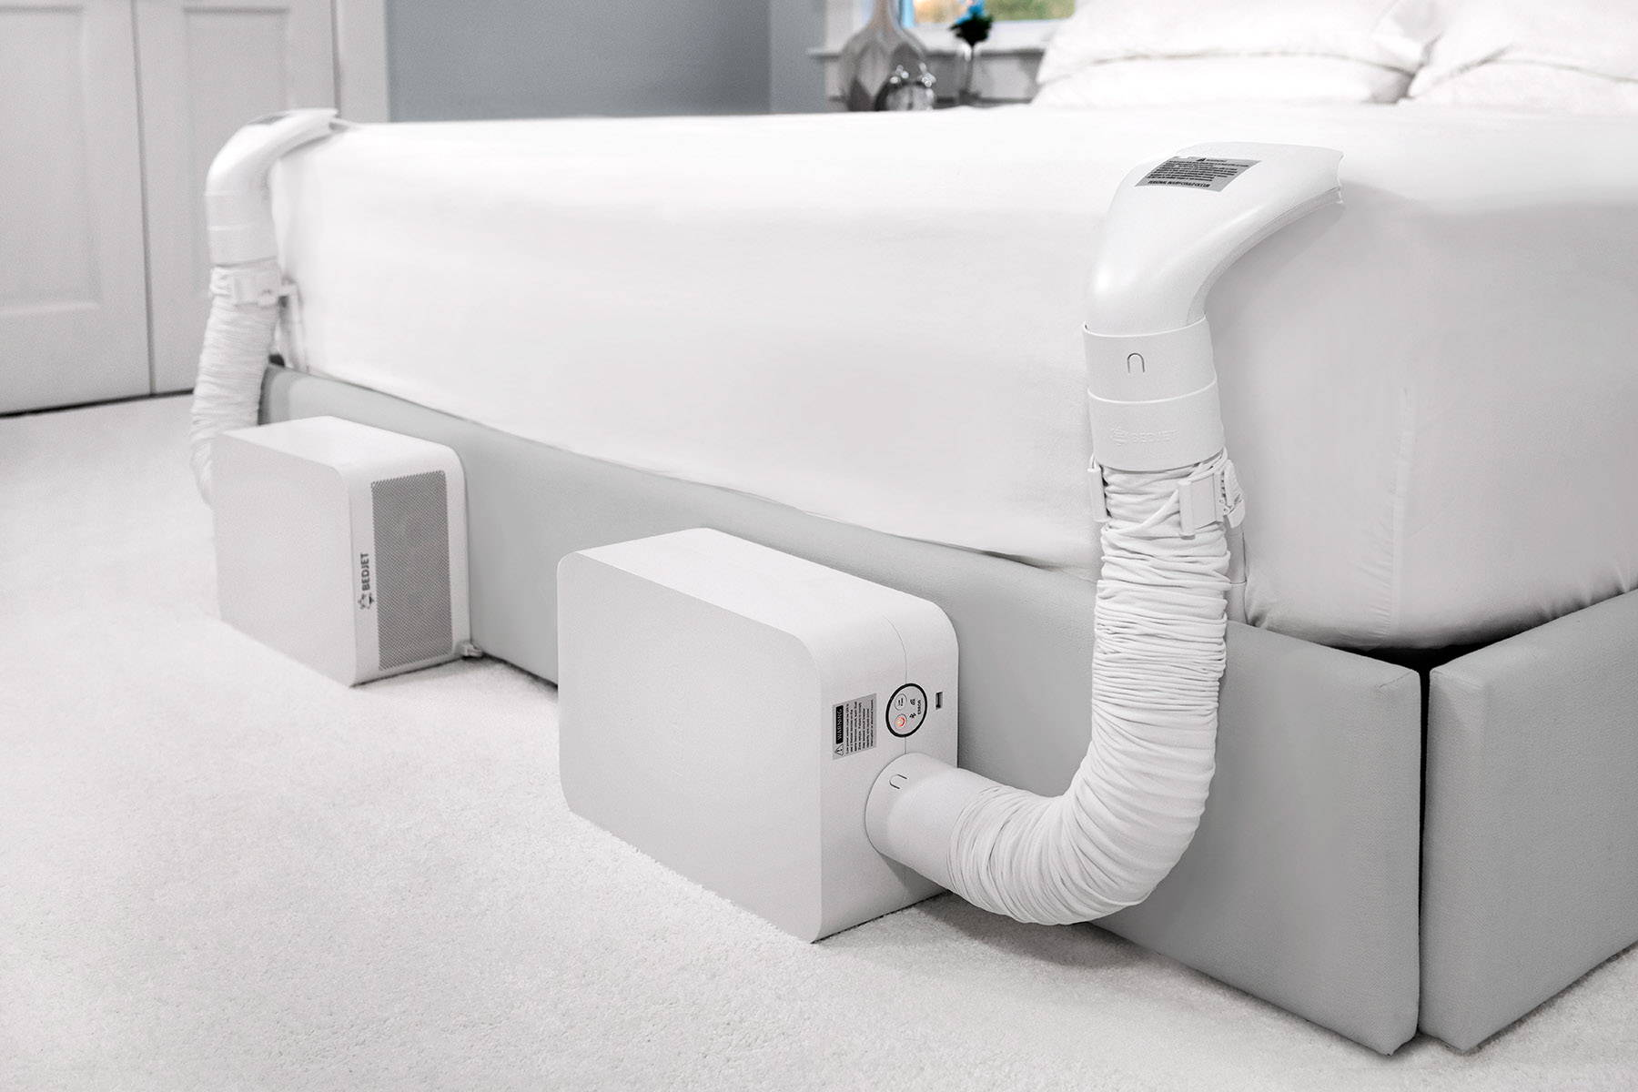
Iteration 2
• The noise may disturb the baby’s sleep.
• It can cause unsafe temperature changes.
• There’s a risk of choking or entanglement.
Bed-jet

Slide 31
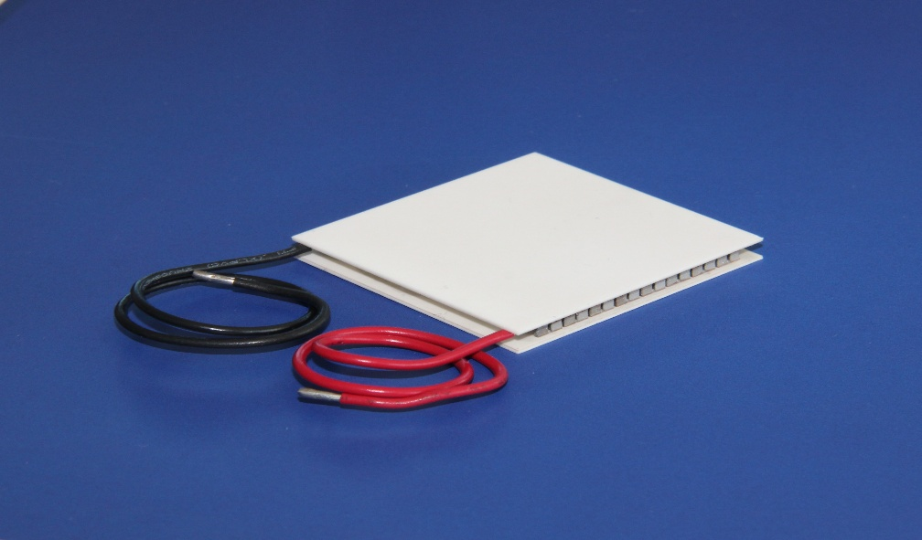
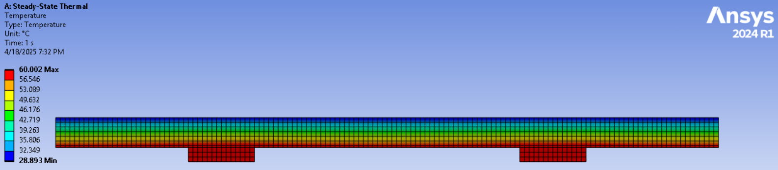
Final Iteration
Peltier Cell

Slide 32
07
Bracelet Electrical system

Slide 33
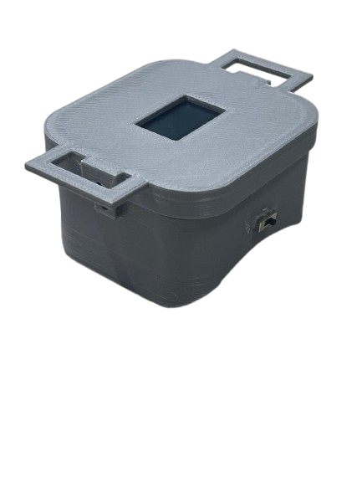
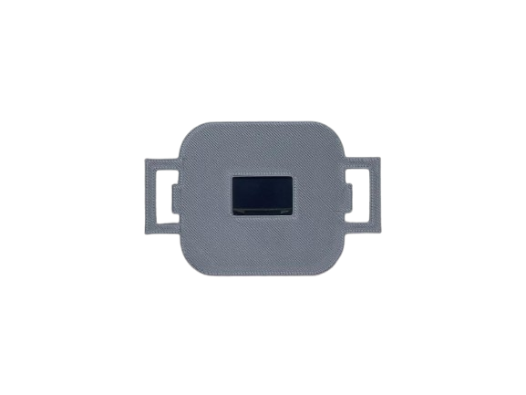
Bracelet Aims
• Compact
• Low power consumption
• Provide accurate Health readings
• Fully wireless
• Safe and reliable

Slide 34
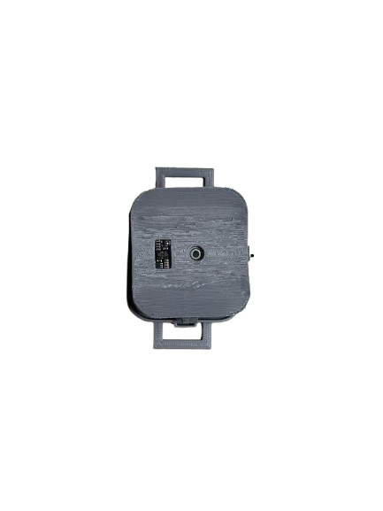
Bracelet Subsystems
1-Sensory system
Sens:
Surface &ambient
temperature
MAX30102
Sens:
Heart rate
SPO2
Presence
MLX90614
(Bottom View)
Advantages: Compact, cost, effective, good precision

Slide 35
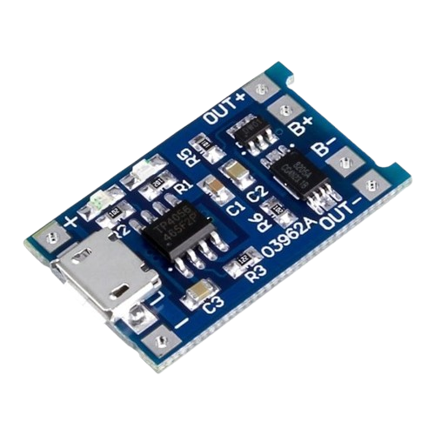
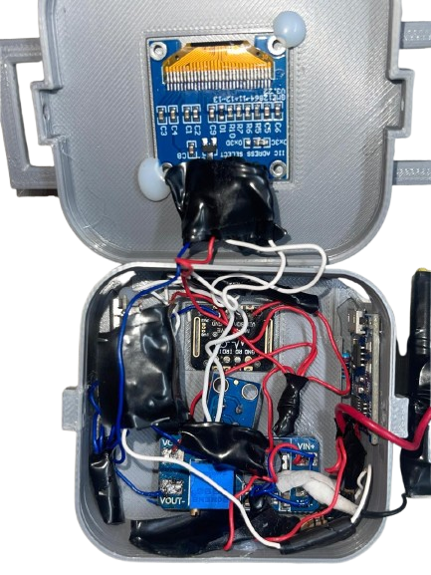
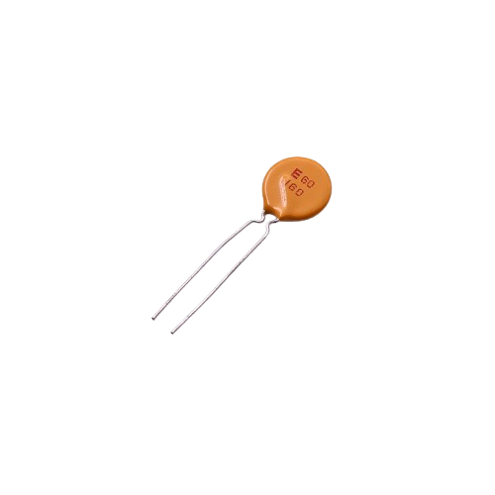
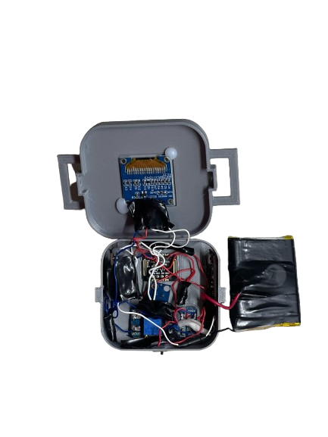
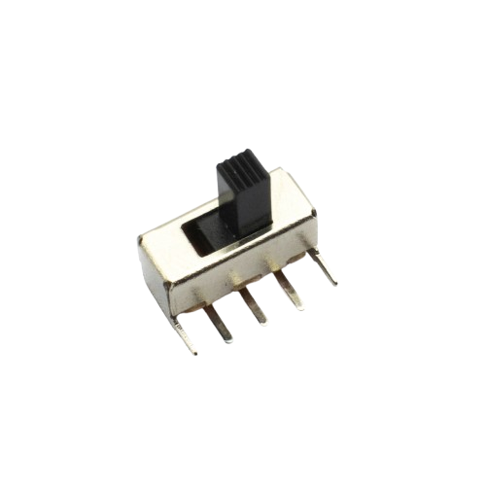
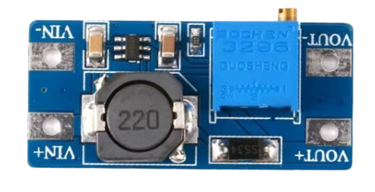
Bracelet Subsystems
2-Power System
4- Resettable Fuse
RXE 160 1.6A
1-TP4056 Lithium Battery Charger Module
5- Lithium-polymer Battery
3.7V 1100mAh
2-Switch
3- MT3608 2A -Step Up Modulef from 3.3-4.2 → 5V

Slide 36
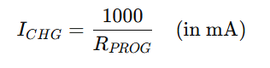
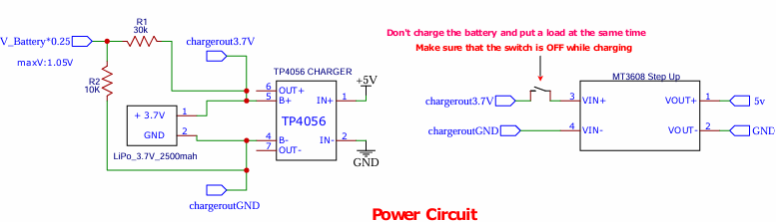
Bracelet Subsystems
2-Power System
(Max charging Current = 1A)
Charging at 0.5c (550 ma)
Higher battery life
Rprog = 1000 / ((0.5) *1100ma) =1.8kΩ

Slide 37
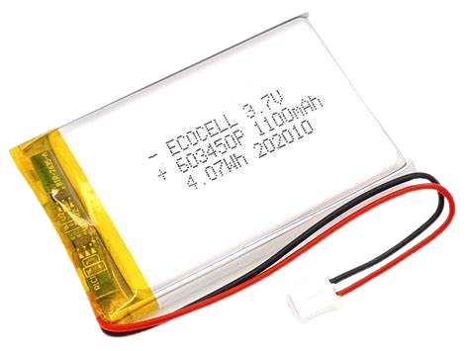
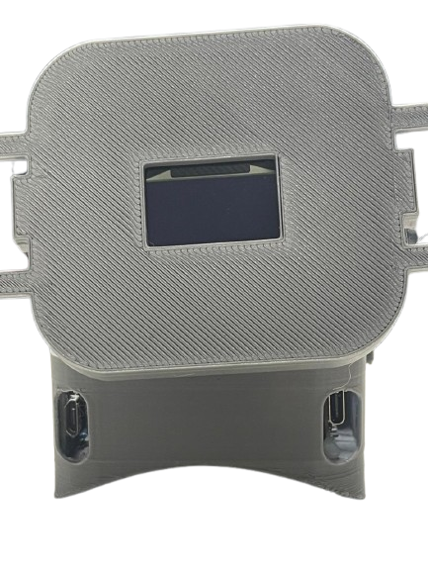
Bracelet Subsystems
2-Power System
System working hours : 1100mAh / 200mA = 5.5h
Resettable Fuse provide short cicuit protection
Switch is isintial to stop the load while charging
Lipo battery3.7V 1100mAh
Charging port
Programing port
Charging status LED

Slide 38
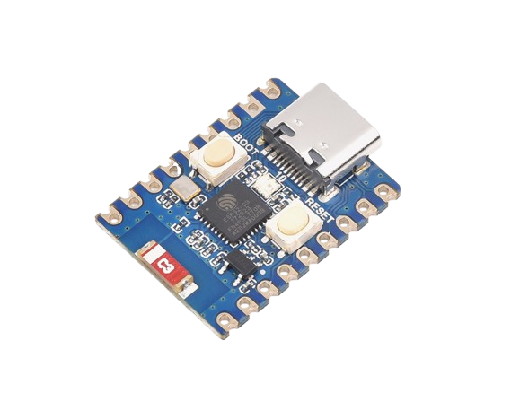
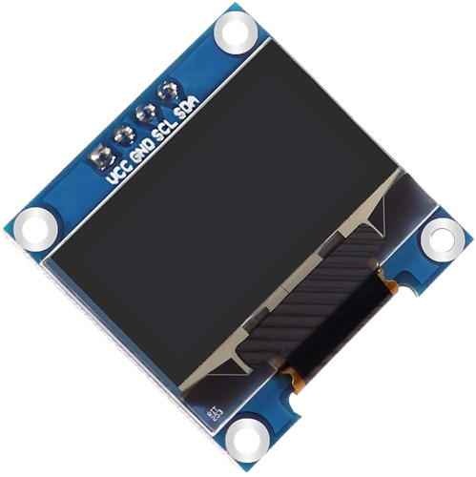
Bracelet Subsystems
3-Actuating System
0.96" Inch Blue I2C IIC OLED LCD
ESP32-C3 Mini
compact size
low power consumption
wireless communication.

Slide 39
08
Bracelet Algorithm

Slide 40
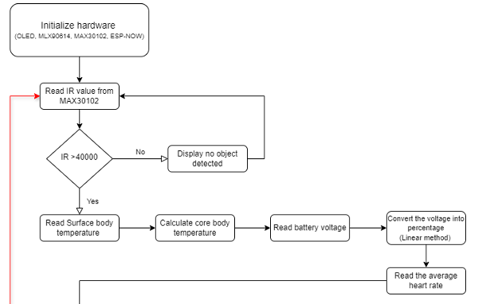
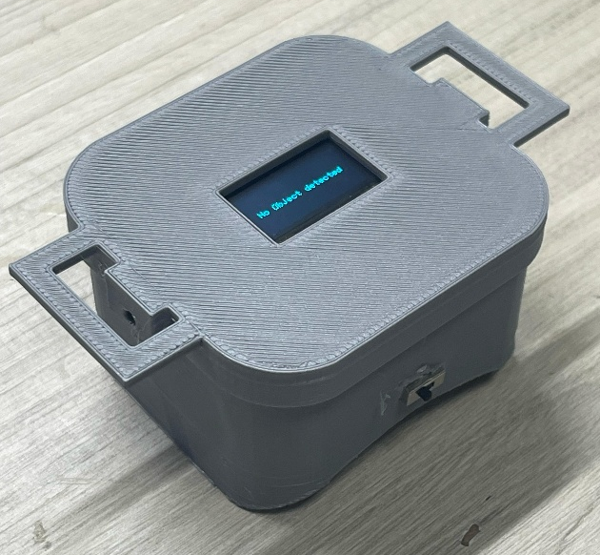
Bracelet Algorithm
reading sensory values
reading sensory values → printing them → sending them via ESP-NOW

Slide 41
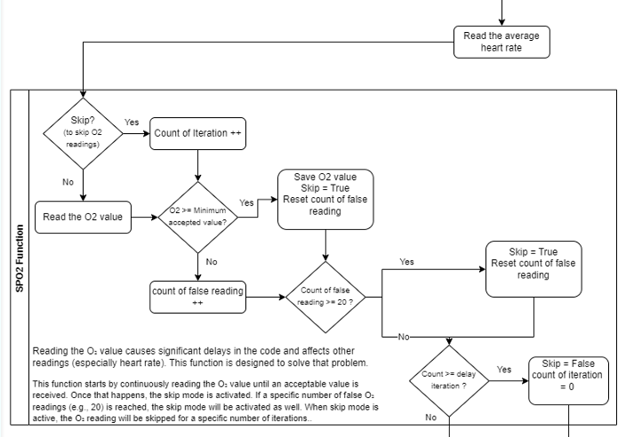
reading sensory values
Slow Readings:
Heart rate is measured by taking multiple sample, they accumulate.
SpO2 and heart rate interfere with each other
SpO2 library introduces delays due to internal loops, so it's triggered periodically (after a set number of iterations).

Slide 42
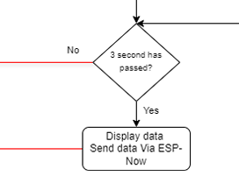
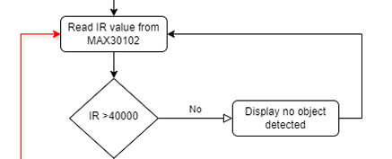
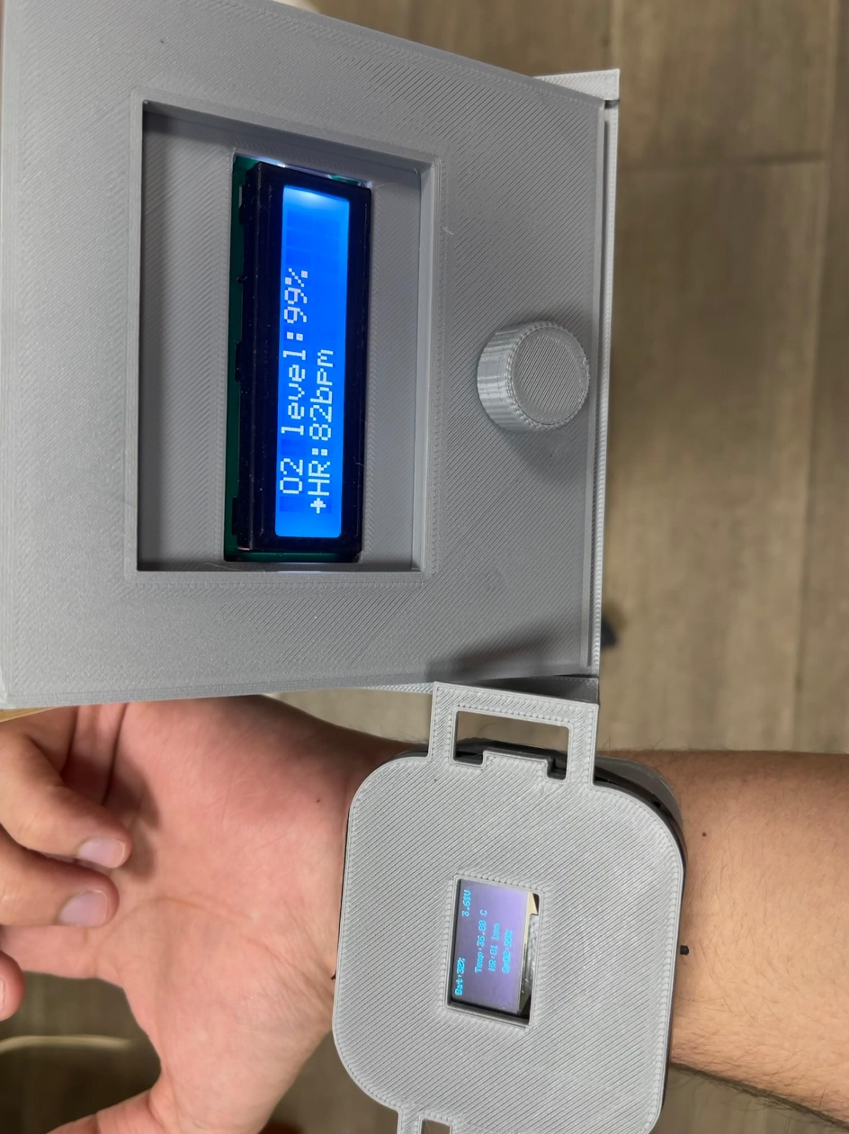
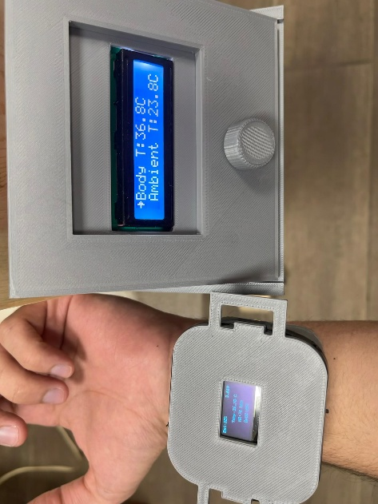

Printing and Sending
Repeat
Data receiver
ESP-Now

Slide 43
Crib System
09

Slide 44

Electrical system of the crib

Slide 45

Main source
Voltage Level | Purpose | Powered Components
240V AC | Mains input | Enters PSU for conversion
12V DC | Motor drive and base voltage | Bosch C300 motor, BTS7960 driver
5V DC | Control logic and sensors | Arduino, LCD, sensors
3.3V DC | Wireless module | ESP32, sensors

Slide 46

Codes and Stranders
IEC 60898-1 – Circuit-breakers
.
IEC 60950 / IEC 62368 – Safety of power supplies and IT equipment
IEC 60287 – Electric cables - Calculation of the current rating

Slide 47

Mode of operation
Interface : 16x2 screen
Control : Rotary encoder
What is a rotary encoder:
Electro-mechanical device
Position
Angle
Push button

Slide 48



Algorithm-1

Slide 49


Algorithm-2
Crying status :
Failed to implement AI
Approach threshold and time
30 s to not affect brightness
Motor :
Press to option screen
Long press meaning
Turn on/off
Magnetic encoder
Turn off initial position

Slide 50



Algorithm-3
Music:
Press
Long Press
Without mp3
Choose song
3 songs
Repeat till stop song
Light:
Press
Long Press
On 4 leds below the chase
Turn off

Slide 51

Algorithm-4
Cooling/Heating:
Choose heat or cool
Relay
Peltier
Auto Mode:
Press
Long press
Conditions to work
Time
Orders
Reads of sensor will still appear

Slide 52

10
communication

Slide 53
Communication Subsystems
three Subsystems
Bracelet and Crib
Crib and mobile app
Web page and firebase

Slide 54

Communication Subsystems
Bracelet and Crib Subsystems
ESP-now advantages
direct, peer-to-peer communication
low latency and fast data transmission
low power consumption
reliability and robustness communication
ranges up to 220 m (ideal conditions) or 50–100 m (typical indoor environments)
we use a packed structure composed of fixed-size unsigned integer types (uint8_t and uint16_t)
it reduce message size, saving bandwidth and processing time

Slide 55



Communication Subsystems
Crib and mobile app
Sensory and status data
Firebase Side

Slide 56

Communication Subsystems
Crib and mobile app
Commands data
Firebase Side

Slide 57


Communication Subsystems
Web page and firebase
Firebase Side
Hosted by GitHub. Data from more than 7 days will be deleted.
ISO 8601 format.

Slide 58
Communication Codes & Standers
Standard / Protocol | Name / Description | Usage & Key Safety Features
ESP-NOW (IEEE 802.11 variant) | Low-power wireless protocol | - Battery-efficient for bracelet - Fast, stable data transfer - No Wi-Fi needed
UART (ANSI/TIA/EIA-232-F) | Serial communication | - Simple wiring - Reliable short-range link - Fast command exchange
NTP (RFC 5905) | Time synchronization | - Real-time data logging - Accurate health tracking - Auto-cleanup of old data

Slide 59

11
Mobile Application

Slide 60



Screens and software used
Screens available
MIT Blocks programming

Slide 61




Home and auto mode screens
Auto mode is OFF
Auto mode is ON

Slide 62


Graphs and Live stream Screens
The user can reach those graphs from any search engine
The phone application is displaying the web page
For future work

Slide 64
12
Conclusion

Slide 65
Future work
Add live streaming system
Improve sensor reading accuracy
Upgrade to a larger screen
Integrate a machine learning model for cry detection
Improve and Develop an iOS version of the mobile app

Slide 66
(Live Demonstration)

Slide 67
Thanks
Q & A

